Slide 1
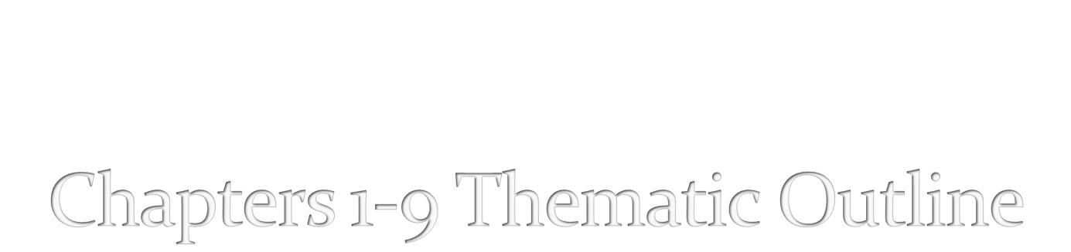
by Ashlee Fox

Slide 2

Men
Jackets(outer most layer), Hats(go on top of the head), shoes(go on your feet), belts(hold pants up), uniforms(in the army), vest(over the shirt), pantaloon(puffy paints), armor(battle), and basinet(helmet).
Women
Girls did their make up, earrings, bracelets, necklaces, blouse(a shirt), dresses(outer most layer), lace(for design), corsets(for the breasts), braise(undergarments), hose(leggings), doublet(hold stockings up), cloak(hood), chaperon(type of hat), nightwear(clothes to sleep in), trains(go over the dress for special occasions, and angel sleeves(long sleeves with wide ends).

Slide 3
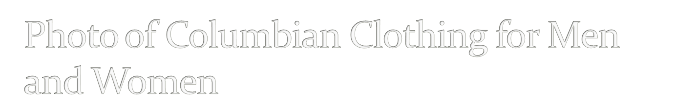
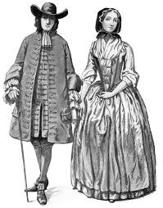
Notes:
I put up a photo of a man to show the type of clothing he was wearing. This photo includes the hat, the cloak, and a shirt for the man. The women shows her dress with a corset and a hood.

Slide 4

Men
Linen(shirts), doublet(top that comes with sleeves), gloves(worn when its cold), armor(for war), vest(over a shirt), and jacket(outer most worn layer).
Women
Stomacher(puffed sleeves), hats(head), hairnets(for hair), train(full body garments), gable hood(wired headdress), coifs(worn under fur hat), necklace( worn on the neck), bracelet(on the wrist), earrings(on the ears), gloves(for the hands), jerkin(a skirt), hose(stockings), and gown(dress).

Slide 5

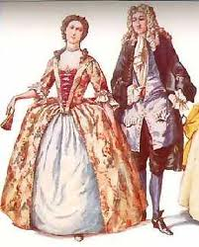
Notes:
Here is a photo of a men dressed in European clothing. He is showing off the rich clothing, such as a jacket, shoes, hose, pants, and doublets. The women is wearing a dress, with a hat, and a corset.

Slide 6

Men
Shirts, Dhoti(white sheets of cloth), No shoes, and Pants(made of cloth).
Women clothing
Bindi(make up), Pavada(long skirt), Blouse(a shirt), Dhoti(white sheets of cloth), Sari(long shirts with pattern on it), and Saree(undergarments).

Slide 7

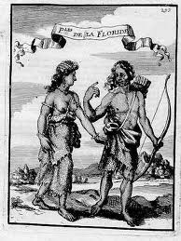
Notes:
I was lucky enough to find a photo with a women and a man in a photo together to show you their outfits. The man isn’t wearing shoes, a skirt that was made of skin or cloth. The women is wearing almost the same thing, but used bindi for make up.

Slide 8

Angel sleeves- long sleeves that are wide at the ends.
Wimpy- for older women and nuns.
Train- full body inner garments.
Coifs- worn under fur hats.
Bindi- used for make up.

Slide 9

Hose is a shirt?
  True
  False
Saree goes over a dress?
  True
  False
3. Corsets are used for your legs?
  True
  False
Indians used angel sleeves?
  True
  False
Stomacher is a skirt?
  True
  false

Slide 10
6. A jerkin is a shirt?
  True
  False
A saree is a hat?
  True
  False
Coifs are stockings?
  True
  False
Indians used make up?
  True
  False
The Indians used make up made of bindi?
  True
  False

Slide 11

1.B
2.B
3.B
4.B
5.B
6.B
7.B
8.B
9.A
10.A

Slide 12

1. http://www.history.org/foundation/journal/winter03-04/clothing.cfm
Copyright 2004-2010 by the Georgia Humanities Council and the University of Georgia Press.
2.http://www.americancenturies.mass.edu/activities/dressup/notflash/1700_woman.html
Women’s Clothing from 1700’s, © 2008 Pocumtuck Valley Memorial Association, Deerfield, Massachusetts, October 16, 2010
3. Tara Maginnis, Ph.D., The Costumer’s Manifesto-costumes.org-17th Century Fashion
Her website- http://www.costumes.org/history/100pages/17thlinks.htm
4. Black, J. Anderson and Madge Garland- A History of Fashion, Morrow, 1975

Slide 13
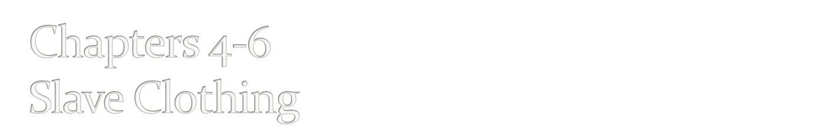
Men and Women
Wear a cotton gown(for sleep), Winter comes around they were given shoes and a jacket, shoes must last a year, hemp(cheap and easy to find to make clothes), slaves who worked for rich people go hand-me-downs, and smocks(to work in).

Slide 14

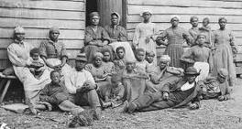
Notes:
This photo shows the men and women that were slaves and what they wore. All their clothes are pretty worn down, They are all wearing hemp and/or cotton.

Slide 15

Men
Indigo(for coloring), used cotton(cloth making), Boots or shoes(for the feet), coats(outer layer), pants, and hat.
Women
Dresses(outer layer), Skirts(under hoods), hat, make up, earrings, Blouse(a top), indigo(cloth coloring), and angel sleeves(log sleeves that were wide at the ends.

Slide 16
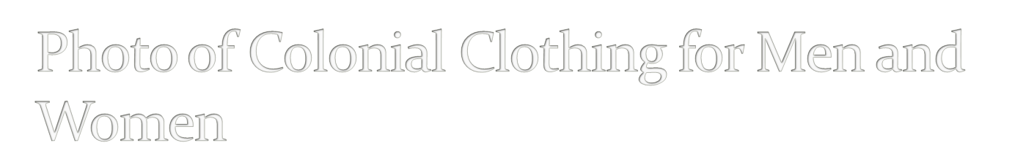
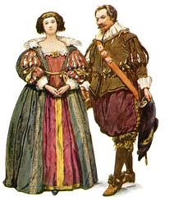
Notes:
The photo shows the rich people of the Colonial period. A dress with a corset for the women. The puffy paints for the man along with his hat, shoes, and shirt.

Slide 17

Men
Lace(for decorating clothes), Ribbon, Court dress for men(wear it in court rooms), breeches(wear on the legs), and pantaloons(go on the thighs).
Women
Brocades(fabric woven), periwig(a wig), dinner dresses, dresses(tight), corset(for the breast), linen, wooden shoes, powder, make up, jewelry, and afternoon dress.

Slide 18
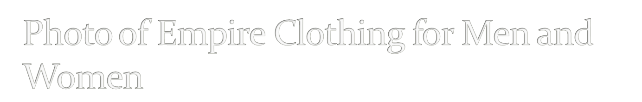
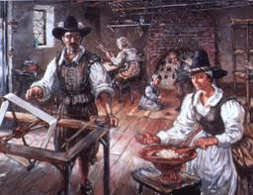
Notes:
You can see the color that their clothes have and hats that have design.

Slide 19
Indigo- a blue dye used on clothing.
Linen- fabric woven from the flax yarns.
Periwig- a wig.
Hemp- a tall, coarse plant to make clothes.
Court dress- the formal costume required to be worn at a royal court on ceremonial and other occasions.

Slide 20

When winter came around, slaves were given hats?
  True
  False
The slaves used indigo for food?
  True
  False
Both men and women slaves wore cotton gowns?
  true
  False
Slaves working for rich people wore hand-me-downs?
  True
  False
Both men and women wore lace?
  True
  False

Slide 21
6. Hemp was hard to find?
  True
  False
7. Men wore corsets?
  True
  False
Women broke their ribs to fit in corsets?
  True
  False
People from the empire wore colored clothes?
  True
  False
Men wore skirts?
  True
  False

Slide 22
1.B
2.B
3.A
4.A
5.A
6.A
7.B
8.A
9.A
10.B

Slide 23
http://www.history.org/foundation/journal/winter03-04/clothing.cfm
Copyright 2004-2010 by the Georgia Humanities Council and the University of Georgia Press.
2.http://www.georgiaencyclopedia.org/nge/Article.jsp?id=h-841
October 16, 2010
3. Aileen Riberiro- A fashion Historian
4. Black, J. Anderson and Madge Garland- A History of Fashion, Morrow, 1975

Slide 24

Men
Smart summer suit, Tight coat, Plain cloth, Pockets, Waist coast plain, Breeches(tight and fasten below the knee), Shirt(frilled at the cuff and around the neck is a knotted muslin or lace cravat), Wears his own hair, Formal occasions he would wear a wig pulled back in a hair tie, More occasional coat, Band collar.
Women
Sackback dress-undress gowns, Corsets underneath-for the breast, Cane side hoops-for supporting skirts, Kerchief-linen pocket, Wing-like cuffs, Round muslin cap, Formal dresses more decorated, Redingote -riding coat, Cotton, Linen, Small and large hoops, False rump-on the hips, Dilated hips-used for attention, Open robes

Slide 25
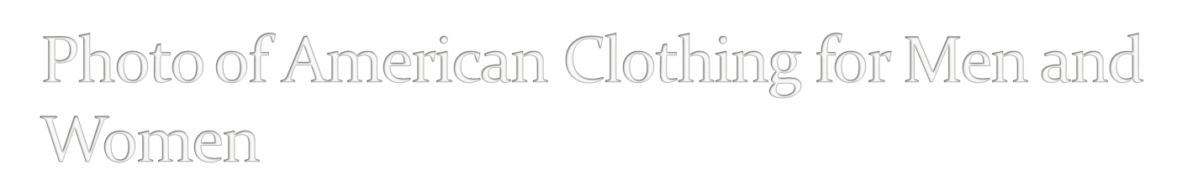
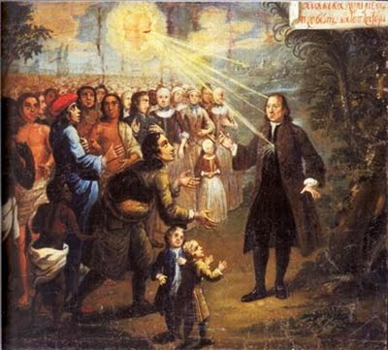

Slide 26

Men
Jackets-most outer layer, Hats(or the head), Shoes or boots(for your feet), Belts(to hold up the paints), Uniforms(if they are in the army), Vest(over the shirt), Pantaloon(puffy paints), Armor(for battle), Basinet(for the head), Gloves(for hands), Tie(for special occasions), Cloak(hood), Angel sleeves(long sleeves that were wide at the ends), Lace(used for design), Cotton(to make clothes), Indigo(color for clothes)
Women
Make up, Jewelry(or women), Blouse-(a top), Dresses(most outer layer), Lace(for design), Corsets(for the women’s breast), Braise(undergarments), Hose(leggings), Doublet(a belt to hold stockings up), Cloak(hood), Nightwear(clothes to sleep in), Trains(over the dress for formal occasions), Angel sleeves-(long sleeves that are wide at the ends), Wimpy(used for old women and nuns), Indigo(color clothes), Cotton(make clothes)

Slide 27
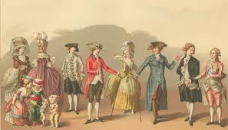

Slide 28
Blouse- a shirt that women wore that has a collar.
Angel sleeves- long sleeves that were wide at the ends.
Corsets- use to hold the women’s breast.
Doublet- a belt used to hold the stockings up.
Braise- worn under their dresses and suits.

Slide 29

1. Did men wear uniforms to sleep in?
  True
  False
2. A basinet is a towel?
  True
  False
3. Pantaloons are puffy pants?
  True
  False
A corset is used for the head?
  True
  False
Men and women both used cloaks?
  True
  False

Slide 30
6. Women wore make up?
  True
  False
Men and women wore skirts to bed?
  True
  False
8. Indigo was used for coloring clothes?
  True
  False
Girls wore jewelry?
  True
  False
Cotton is used to make clothes?
  True
  False

Slide 31
1.B
2.B
3.A
4.B
5.A
6.A
7.B
8.A
9.A
10.A

Slide 32
1. http://www.historic-uk.com/CultureUK/Clothing-Georgians.htm
British Fashion, Culture UK, October 16, 2010
2. http://www.americancenturies.mass.edu/activities/dressup/notflash/1700_woman.html
Women’s Clothing from 1700’s, © 2008 Pocumtuck Valley Memorial Association, Deerfield, Massachusetts, October 16, 2010
3. Tara Maginnis, Ph.D., The Costumer’s Manifesto-costumes.org-17^{t} Century Fashion
Her website- http://www.costumes.org/history/100pages/17thlinks.htm
4.Beth Gilgun- Wrote: "Tidings from the 18th Century" - by Beth Gilgun
Her website- http://www.englishcountrydancing.org/sources.html

